Slide 1


Introduction to Prompt Engineering
Unlocking the Power of Language Models
Prompt engineering is the art of crafting effective inputs to guide and manipulate powerful language models, unlocking their true potential to assist with a wide range of tasks.
by Akshitha sai

Slide 2

What is Prompt Engineering?
1
Defining Prompt Engineering
2
Leveraging Language Models
The process of carefully designing prompts to elicit the desired outputs from language models.
Prompt engineering allows users to harness the vast knowledge and capabilities of large language models.
3
Personalized Responses
Crafting prompts that align with specific needs and preferences to generate tailored outputs.

Slide 3
Importance and Applications
Improved Productivity
Enhanced Creativity
Versatile Applications
Prompt engineering can streamline tasks, automate workflows, and boost efficiency across industries.
Prompts can inspire novel ideas, enable personalized content generation, and foster innovation.
Prompt engineering can be applied to a vast array of domains, from writing and coding to analysis and problem-solving.

Slide 4

Basics of Designing Effective Prompts
Clarity and Specificity
Contextual Awareness
Prompts should be well-defined, unambiguous, and provide clear instructions to the language model.
Prompts should consider the relevant context, tone, and desired outcomes to guide the model's response.
Iterative Refinement
Ethical Considerations
Prompts may require multiple iterations and testing to achieve the desired results.
Prompts should be designed with ethical principles in mind to ensure responsible AI usage.

Slide 5
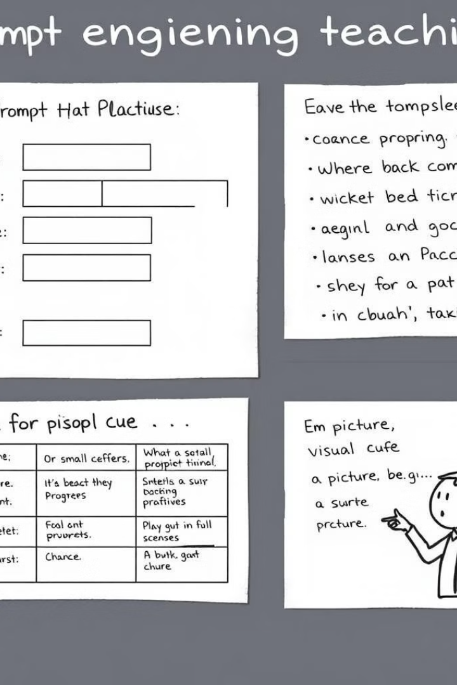
Techniques and Best Practices
1
Template-Based Prompts
Leveraging pre-defined structures to streamline prompt creation and ensure consistency.
2
Example-Driven Prompts
Providing relevant examples to guide the language model and set clear expectations.
3
Multimodal Prompts
Incorporating visual cues, data, and other media to enhance the prompt's effectiveness.

Slide 6





Real-World Examples
Content Creation
Software Development
Generating high-quality articles, stories, and marketing copy through prompts.
Automating coding tasks, debugging, and prototyping with prompt-based tools.
Data Analysis
Problem-Solving
Utilizing prompts to extract insights, summarize findings, and generate reports.
Prompting language models to assist with brainstorming, ideation, and decision-making.

Slide 7




Challenges and Future Trends
Ethical Considerations
Addressing concerns around bias, transparency, and the responsible use of prompt-based AI.
Multimodal Advancements
Integrating prompts with other data sources, such as images, videos, and sensors.
Personalization and Adaptation
Developing prompts that can dynamically adjust to individual user preferences and needs.

